Slide 1
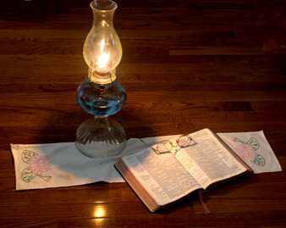
Language of Ashdod
Nehemiah 13:23-25
“In those days I also saw Jews who had married women of Ashdod, Ammon, and Moab. 24 And half of their children spoke the language of Ashdod, and could not speak the language of Judah, but spoke according to the language of one or the other people. 25 So I contended with them and cursed them, struck some of them and pulled out their hair, and made them swear by God, saying, "You shall not give your daughters as wives to their sons, nor take their daughters for your sons or yourselves.”
The Holy Spirit chose WORDS to express Divine Ideas and caused them to be Written in the Old and New Testaments
Language: “The use by human beings of voice sounds, and often written symbols representing these sounds, in organized combinations and patterns in order to express and communicate thoughts and feelings.”

Slide 2
Language of Ashdod
Wholesome {Sound} Words
1 Timothy 6:3
2 Timothy 1:13
All Teaching MUST Conform to the Pattern of Sound Words

Slide 3
What Is The
Language of Ashdod?
  History of Mixed Marriages
  Children Spoke ½ Speech of Ashdod and ½ Language of Judah
  Could not express ideas of Law of Moses
  Could Not Understand Law
  Lost ideas of God

Slide 4
What Is The
Language of Ashdod
Today?

Slide 5
The Misuse of Scriptural Terms
Pastor
Eph 4:11
Acts 20:28
Priest
Rev 1:6
Heb 5:10
Church
Ac 20:28
Ac 8:3
Saints
Phil 4:21-22
1 Cor 6:11

Slide 6
Replacing Scriptural Terms
Lord’s Supper replaced by “Sacrament”
Bible Class replaced by “Sunday School”
Church replaced by “Parish”
Doctrine replaced by “Statement of Faith”
Preaching replaced by “Outreach”
Teaching replaced by “Witnessing”

Slide 7
Language of Ashdod
The Language of Ashdod is a blending of the Biblical with denominationalism / world.

Slide 8
Some Christians today Talking About:
Join the Church
Acts 2:47
“My, Your, Ours”
Matthew 16:18
Chapter and Verse?
Devotionals
Not used before 1250
Christianity

Slide 9
“Fellowship”
With God and Christ – 1 John 1:7
With Saints in Christ – 1 John 1:3
In Lord’s Supper –
1 Corinthians 10:16
In Suffering for Christ –
2 Corinthians 1:6-7
In Work and Worship of The Lord – Acts 2:42; 2 Corinthians 8:23

Slide 10
“Fellowship”
Financing Lord’s Work – Acts 2:42; 1 Timothy 6:18
Supporting a Preacher –
Philippians 1:5; 4:15
For Necessity of Saints –
Romans 12:13; 2 Corinthians 8:4; 9:13
Where do the Scriptures use this Word to denote a social meal?

Slide 11
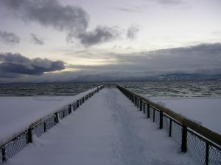
Where this path takes us!
Believe Christians in all Denominations
Everything is a Romans 14 Issue
Rejection of Doctrinal Sermons
Accepting of the Unbaptized

Slide 12
How Should We Speak?
1 Peter 4:11
If anyone speaks, let him speak as the oracles of God. If anyone ministers, let him do it as with the ability which God supplies, that in all things God may be glorified through Jesus Christ, to whom belong the glory and the dominion forever and ever. Amen.

Slide 13
How Should We Speak?
Speak where the Bible Speaks, Remain Silent where the Bible is Silent, Do Bible things in Bible ways, and Call Bible things by Bible Names

Slide 14
Is it Possible to Rise to the Noble Teaching of the New Testament?
OR Must we speak the “Language of Ashdod”?
Nehemiah “… contended with them and cursed them, struck some of them and pulled out their hair, and made them swear by God, saying, ‘You shall not give your daughters as wives to their sons, nor take their daughters for your sons or yourselves.’”

Slide 15
Does God View us with any Less Disdain When We Speak The “Language of Ashdod”?
Titus 2:7-8
“in all things showing yourself to be a pattern of good works; in doctrine showing integrity, reverence, incorruptibility, 8 sound speech that cannot be condemned, that one who is an opponent may be ashamed, having nothing evil to say of you.”

